Slide 1

Institute of Technology
School of Computing
Department of Software Engineering
Fundamentals of Cloud computing
“Chapter 3 :Architectural Design of Compute and Storage Clouds”
By Abebaw S.

Slide 2
Outline
Generic cloud architecture
Layered Cloud Architecture
Architectural Design Challenges
Inter Cloud Resource Management
Resource Provisioning and Platform Deployment
Resource provisioning methods
Global Exchange of Cloud Resources

Slide 3
A generic Architecture Design
Cloud architecture is intended to design to process massive amount of data with high degree of parallelism.
The followings are the major design goals of cloud architecture
Scalability
Virtualization
Efficiency
Reliability

Slide 4
Cont’d. . .
Scalability: Cloud can be easily expanded by adding more servers and enlarging network connectivity accordingly.
Virtualization: The cloud management software needs to support both physical and virtual machines.
Efficiency: The Hardware and software systems are combined to make it easy and efficient to operate.
Reliability: Data can be put into multiple locations. In such situation even if one of the data center crashes, the user data is still accessible.

Slide 5
Cont’d. . .
However, security in shared resources and shared access of data centers pose a design challenges.
Clouds support web 2.0 applications
Cloud management receives the user request, find the correct resources and then calls the provisioning services which invoke the resources in the cloud.

Slide 6
Enabling Technology for Clouds
The key driving forces behind cloud computing are
Ubiquity of broadband and wireless networking
Falling storage costs, and
Progressive improvement in Internet computing software.
Ubiquity: existing every where at the same time

Slide 7
Cloud Enabling Technologies in HW, SW, and Networking
Fast platform deployment: flexible deployment of cloud resources
Virtual clusters on demand: to be provided and cluster need to be reconfigured as workload changes
Multitenant techniques: distributing software to a large number of users simultaneously
Massive data processing: internet search and web services required this process.

Slide 8
Web scale communication: support for e-commerce, education, social networking medical care etc.
Distributed storage: large scale of storage of data in distributed storage
Licensing and billing services

Slide 9
Cont’d …
Improvements in multicore CPUs, memory chips, and disk arrays made it possible to create faster data centers with much more storage space.
Resource virtualization enables rapid cloud deployment and disaster recovery.
Service oriented architecture (SOA) also plays a vital role
Todays clouds designed to serve a large number of tenants over massive volume of data.
The availability of large scale, distributed storage systems is the foundation of today’s data centers.

Slide 10
A generic Cloud Architecture
The figure in the next slide shows security aware cloud architecture.
The Internet cloud is envisioned as massive cluster of servers.
These servers are provisioned on demand to perform collective web services or distributed applications using data center resources

Slide 11
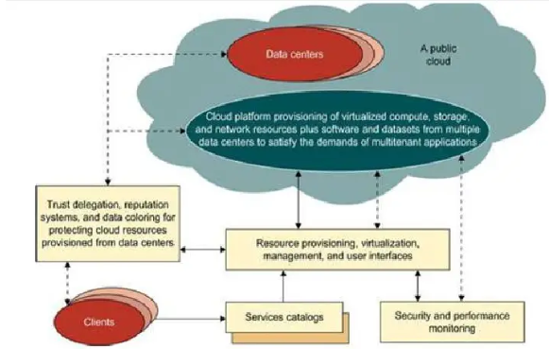
Cont’d …

Slide 12
Cont’d …
The cloud platform dynamically adding or removing servers, software, and database resources as needed.
Servers in cloud can be physical machine or VMs.
In addition to the server cluster, the cloud platform demands distributed storage and accompanying services.
Cloud computing resources are stored in data centers, which are usually owned by third-party providers.

Slide 13
Cont’d …
We need to build framework to process large-scale data to stored in storage system.
This demands a distributed file system over DBMS.
Other cloud resources are added into a cloud platform including
storage area networks (SANs),
DBMS
Firewalls and security devices.
Web service providers offer special APIs that enable developers to exploit Internet clouds.
Monitoring and metering units are used to track the usage and performance of provisioned resources.

Slide 14
Cont’d …
The software infrastructure of the cloud platform must handle all resource management and most of the maintenance automatically.
The software must detect the status of each node server joining and leaving, and preform relevant task accordingly.
In general private cloud easier to manage and public cloud easier to access.
The trends in cloud deployment are that are more and more clouds will be hybrid.

Slide 15
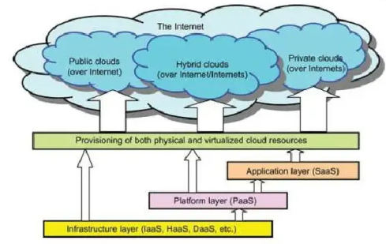
Layered Architectural Development
The Architecture of cloud is developed at three layers
Platform
Application
Infrastructure

Slide 16
Cont’d…
The development layers are created using virtualization and standardized HW and SW resources provided through the cloud.
It is clear that infrastructure layer is deployed first to support IaaS.
The Infrastructure layer serves as the foundation for building the platform to supporting PaaS.
In turn, the platform layer is the foundation for implementing the application layer for SaaS.

Slide 17
Cont’d…
The infrastructure layer is built with virtualized compute, storage, and network resources.
is for general purpose and repeated usage of the collection of software resources.
The platform layer offers an environment to build applications, test processes, and track results and performance.
Virtualized cloud platform serves as “System middleware” between infrastructure and application layer of the cloud.

Slide 18
Cont’d…
The application layer formed with a collection of all needed software modules for SaaS applications.
Service application in this layer include daily office management work, such as information retrieval, document processing, and colander and authentication services.
The application layers also heavily used by enterprise in business marketing and sales such as CRM, financial transaction, supply chain management (SCM) etc.
Generally, SaaS demands the most work from the provider, PaaS is the middle, and IaaS is demands the least.

Slide 19
Market Oriented Cloud Architecture
Cloud providers consider different QoS parameters of each individual consumer as negotiated in specific SLAs.
Market oriented resource management is necessary to regulate the supply and demand of clod resources.
The designer needs to provide feedback on economic incentives for both consumer and providers.
The purpose is to promote QoS-based resource allocation mechanisms.
The figure on the next slide shows the high level architecture for supporting market-oriented resource in cloud computing environment

Slide 20
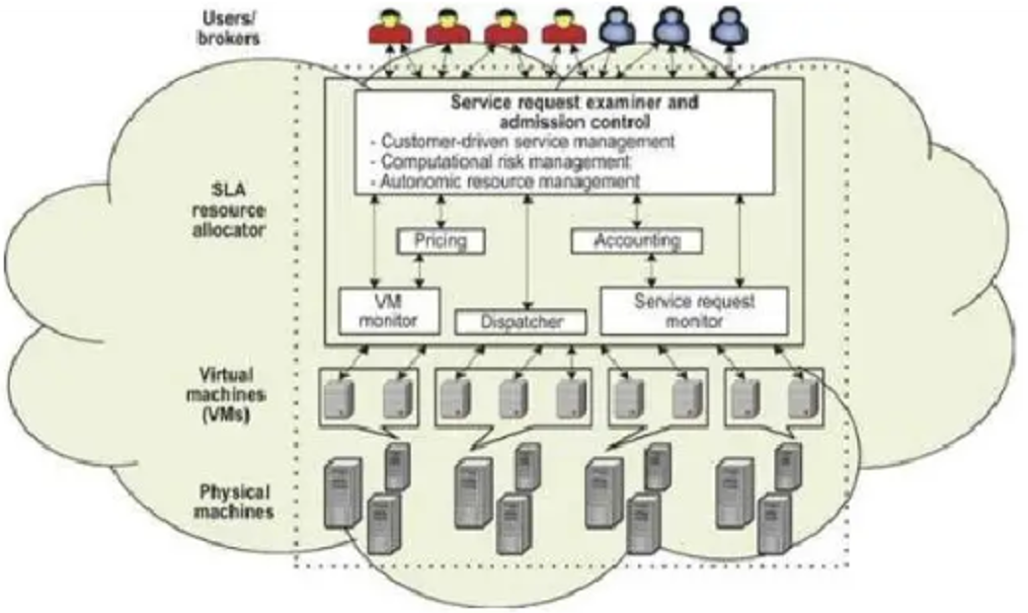
Cont’d…

Slide 21
Cont’d…
User or broker submit service request to the data center to be processed.
SLA resource allocator acts as the interface between the data center and external user
A service request is first submitted the service request examiner, which inspects the request for QoS requirements before determining whether to accept or reject the request.
The request examiner ensures that there is no overloading of resources, after that it assigns and request to VMs and determine entitlements for allocated VMs.

Slide 22
Cont’d…
Pricing
➔ serves as basis for managing the supply and demand of computing resource with in data center
➔ Facilitate prioritizing resource allocations effectively
Accounting
➔ maintains the actual usage of resource by requesting so that the final cost can be computed changed to users.
In addition, the maintained historical usage information can be utilized by service request examiner Admission Control mechanism to improve resource allocation decisions.

Slide 23
Cont’d…
VM monitor
➔ keep track the availability of VMs and their resource entitlements.
Dispatcher
➔ Starts the execution of accepted service request on allocated VMs.
Service Request Monitor
➔ keep track of the execution progress of service requests.

Slide 24
Quality of Service Factors
QoS parameters to be consider in service request are time, cost, reliability, and trust/security etc.
QoS requirements may change over time due to continuing changes in business operation.

Slide 25
Architectural Design Challenges
There are several open challenges in cloud architecture development
Service availability and Data Lock-in Problem
Data Privacy and Security Concern
Unpredictable Performance and Bottlenecks
Distributed Storage and Widespread Software Bugs
Cloud scalability, Interoperability, and Standardization
Software licensing and Reputation sharing

Slide 26
Service availability and Data Lock-in Problem
The management of cloud service by a single company leads to a single point of failure
Even if the company has multiple data centers located in different geographical location, it may have common software infrastructure and accounting systems.
Other availability obstacle is DDoS attack, which make service unavailable to intended users.

Slide 27
Cont’d…
Software stacks have easily collaboration between different cloud platforms, but the APIs are still controlled by individual companies.
The solution is to standardize APIs.
Creates a new way to use the same software infrastructure in both public and private clouds.
Allow for "Surge computing,"
Prevent losing all data if a single company fails.
What is Surge computing?
The public cloud handles extra tasks that can't be easily managed in a private cloud's data center.

Slide 28
Data Privacy and Security Concern
Current cloud services mainly use public networks, which makes the system more vulnerable to attacks.
The problems can be solved with trusted technologies like encrypted storage, VLANs, and middleboxes (like firewalls and packet filters).
Many countries have laws that require SaaS providers to store customer data and copyrighted material within their borders.

Slide 29
Cont’d…
Traditional network attack include buffer overflow, DoS attacks, spam ware, malware, rootkits, trojan horses, and worms
In clod environment newer attack may result from hypervisor malware, guest hopping and hijacking, or VM rootkits etc.
Another types of man in the middle attack for VM migrations
In general the attacks can be passive or active
Passive attack: steal sensitive data or password
Active attack: manipulate kernel data structures which will causes major damage to cloud servers.

Slide 30
Unpredictable Performance and Bottlenecks
In cloud computing, multiple VMs can share CPUs and memory, but sharing I/O resources is difficult.
If applications are spread across different cloud boundaries, it could make placing and transferring data more complicated.
Data transfer bottleneck need to be eliminated, slow connections should be improved, and weak servers should be replaced to reduce costs

Slide 31
Distributed Storage and Widespread Software Bugs
The database in cloud applications is constantly growing.
This is an opportunity to create a storage system that can handle this growth
Taking advantage of the cloud's ability to scale up and down as needed.
This requires designing efficient distributed SANs.
Data centers must meet programmers' expectations interims of
Scalability,
Data availability,
High availability (HA), and
Data consistency checks in SAN-connected data centers; but it is challenging.

Slide 32
Cloud scalability, Interoperability, and Standardization
Google App Engine (GAE) automatically scales in response to load increases and decreases; users are charged by cycles used.
AWS charges by the hour for the number of VM instances used, even if machines idle.
In order to save money scale up and down must happen quickly.
Open Virtualization Format (OVF) describes an open, secure, portable, efficient, and extensible format for the packaging and distribution of VMs

Slide 33
Software licensing and Reputation sharing
Many cloud computing providers initially depended on the open-source software licensing model, but this model is not well-suited for utility computing.
An opportunity would be to create reputation guarding service similar to “trusted e-mails” services currently offered for free to services hosted on smaller ISP.
Cloud providers want legal liability to remain with customer, and vise versa.
This problem must solved at SLA level

Slide 34
Inter-cloud resource management
Inter-cloud resource management refers to the process of managing resources across multiple cloud environment
Cloud environments are public, private, and hybrid clouds.
Resources are compute, storage, and network among others across different cloud providers
Ensuring resource are utilized effectively.
Inter-cloud resource management are the following
Resource Allocation
Load balancing
Interoperability
Security
Cost management

Slide 35
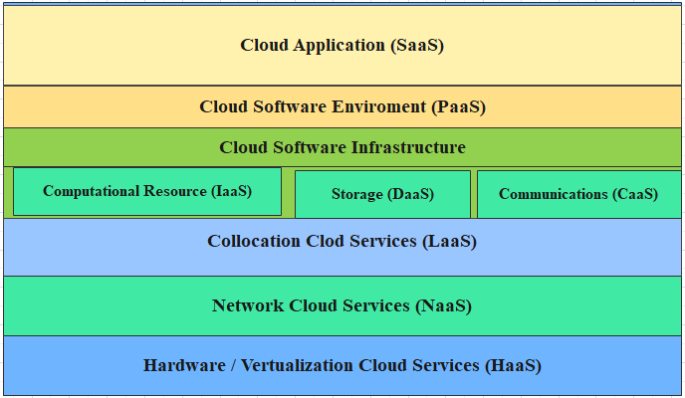
Extended cloud Computing service

Slide 36
Cont’d…
The bottom three layers are related to physical requirements.
The bottom most layer provides HaaS
The next layer provides NaaS: such as VLANs
The next up layer is LaaS: provides location based service to house, power, and secure all physical hardware and network resources
The cloud infrastructure layer can be divided as DaaS and CaaS in addition to compute and storage in IaaS.

Slide 37
Cont’d…
The cloud players are divided in to three classes
Cloud Service providers and IT administrators
Software developer or Vendors
End user or business users
These cloud players vary in their roles under the IaaS, PaaS, and SaaS models.
Example
Software vendors’ perspective, application performance is the most important.
Providers’ perspective, infrastructure performance is the primary concern.
End users’ perspective, QoS, including security, is the most important

Slide 38
Cloud Service Trend and Task
The objective SaaS applications is to expand market coverage by
Investigating customer behaviors and
SaaS applications are also used for distributed collaboration, financial and HRM.
Identifying opportunities by statistical analysis.

Slide 39
Cont’d…
PaaS is provided by companies like Google, Salesforce, Facebook, and others.
IaaS provided by Rackspace, Windows Azure, AWS etc.
Collocation services require various cloud service providers to work together to support the supply chain in manufacturing.
Network cloud services provide communication through providers like AT&T, Qwest, and AboveNet.

Slide 40
Software Stack for Cloud Computing
Cloud computing follows a layered structure
Each layer has its own purpose
Each layer provide the interface for the upper layer
However, the lower layers are not completely transparent to the upper layers.

Slide 41
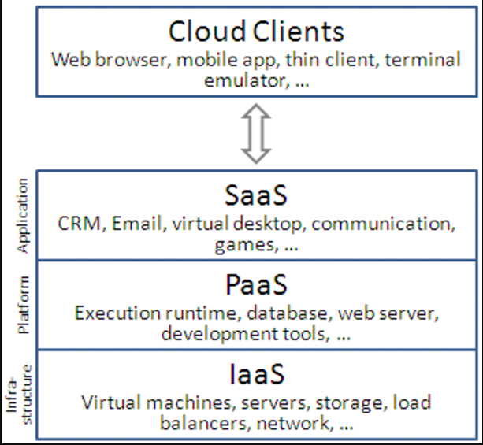
Cont’d…

Slide 42
Cont’d…
Cloud computing services run on either physical or virtual servers, with VMs offering flexibility.
The software layer above the platform stores large amounts of data, acting like a traditional file system.
Other layers on top handle the execution of cloud computing platforms.
They include DB storage system, programming for cluster, data query language support.

Slide 43
Runtime Support Services
As in a cluster environment, there are also some runtime supporting services in the cloud computing environment.
Cluster monitoring is used to collect the runtime status of the entire cluster.
The scheduler queues the tasks submitted to the whole cluster and assigns the tasks to the processing nodes according to node availability.
Browser-initiated applications applied by thousands of cloud customers.

Slide 44
Provisioning of Compute Resource
Provider offer cloud services by signing SLAs
Under-provisioning of resource will lead to broken SLAs.
Over-provisioning of resource will lead resource under utilization, as a result decrease revenue of the provider.
Deploying autonomous system efficiently provision resource to the user is difficult.
The difficulty comes from
Unpredictability of consumer demand
SW and HW failures
Heterogeneity of services
Power management
Conflicts signed SLAs b/n consumers and providers

Slide 45
Resource provisioning methods
There are three cases of static cloud resource provisioning policies
Over-provisioning with the peak load cases heavy resource waste
Under-provisioning of resources results losses by both provider and user
Constant provisioning of resources with fixed capacity decline user demand worse resource waste
There are three resource-provisioning method
Demand driven method
Event driven method
Popularity driven method

Slide 46
Cont’d…
Demand-driven method
Add or remove computing instances based on current utilization level.
When resource has above the threshold for certain amount of time, the scheme increase the resource
When resource is below the threshold for certain amount of time decrease the resource accordingly.
Example: EC2 provided by Amazon

Slide 47
Cont’d…
Event-driven method
Add or remove computing instances based on specific time event.
It is best suited for seasonal events
Minimal loss of QoS, if the event is predicted correctly
Popularity driven method
Create instances based on popularity demand
Minimal loss of QoS, if the popularity is predicted correctly
However the resource may be wasted if the traffic doesn’t occur as expected

Slide 48
Dynamic Resource Provisioning
This model allows cloud service provider to allocate resources based on real time needs. Also known as on demand provisioning
Scalability and performance can be achieved by implementing dynamic resource deployment.
An InterGrid gateway (IGG) manages resources from a local cluster and connects with another IGG
Purpose: allocate resources from a cloud provider.
The figure, in the next slide described allocate resource from a local cluster to deploy application in three steps.
Requesting VMs, Implementing an agreement, Deployment VMs

Slide 49
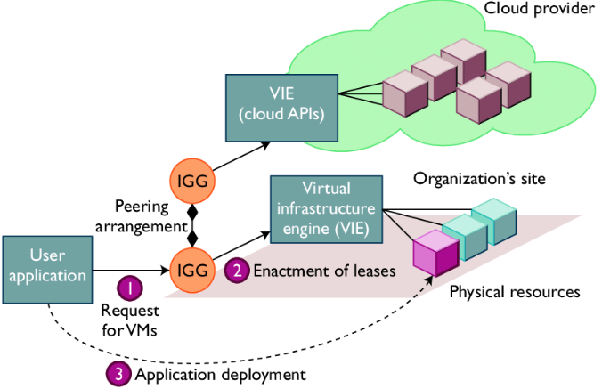
Cont’d…

Slide 50
Cont’d…
An IGG can also allocate resource from cloud providers.
The Intergrid allocate and provides distribute virtual environment (DVEs)
This is virtual clusters of VMs that run isolated from other clusters.
The DVE Manager performs resource allocation for specific user applications.

Slide 51
Cont’d…
The core component of the IGG is scheduler for implementing provisioning policies and peering with other gateways
It uses asynchronous message passing mechanism, which is message is sent without the sender waiting for a reply.
The receiving messages are handled in parallel by thread pool.

Slide 52
Provisioning of Storage resources
Many cloud companies have created large-scale storage systems to handle the vast amounts of data collected daily.
Examples
Google File System (GFS) is a distributed file system designed by Google to store and manage large amounts of data across multiple machines.
GFS store web data and some other data such as Geographic data for google earth.
Hadoop distributed file system (HDFS) for apache, designed to store large volumes of data across a cluster of machines.
Microsoft Cosmos File System (Cosmos FS)

Slide 53
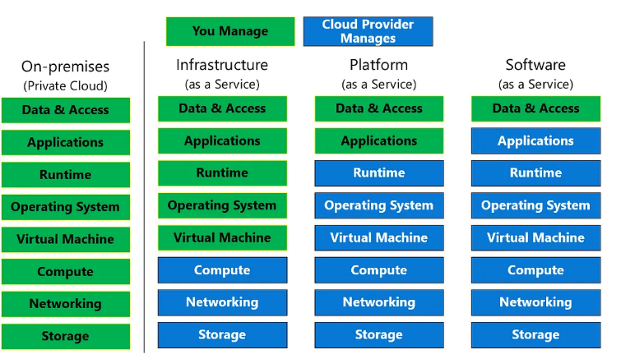
Provisioning of Storage resources

Slide 54
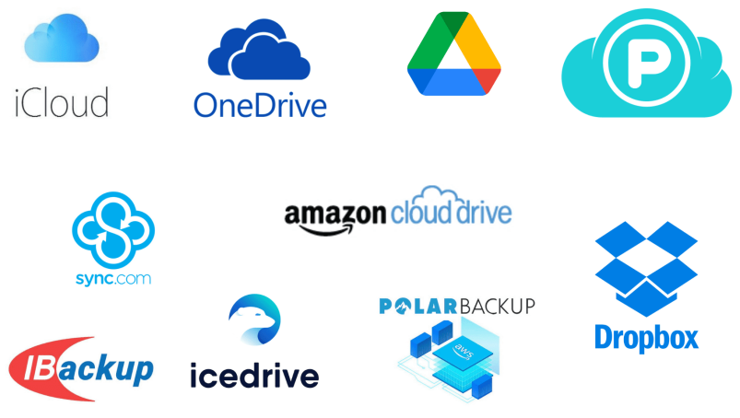
Provisioning of Storage resources
Cloud Storage providers

Slide 55
Global Exchange of Cloud Resources
In order to support a large number of application service consumers from around the world
IaaS providers should established data centers in multiple geographical locations.
Amazon does not provide seamless/automatic mechanisms for scaling its hosted services across multiple geographically distributed data centers.
For example, Amazon has data centers in US (e.g., one on the East Coast and another on the West Coast) and Europe.

Slide 56
Global Exchange of Cloud Resources
This approach has many shortcomings.
It is difficult for cloud customers to determine the best location for hosting their services as they may not know the origin of consumers their services.
SaaS providers may not be able to meet the QoS expectations of their service consumers originating from multiple geographical locations.

Slide 57
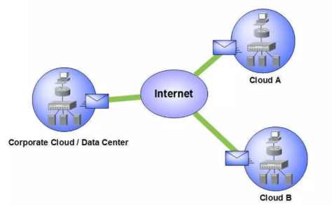

Slide 58
Global Exchange of Cloud Resources
Market directory
Banking system
Brokers
Price setting mechanism
Admission control mechanism
Resource management system
Consumers utility function
Resource management proxy

Slide 59
Global Exchange of Cloud Resources
Benefits
Management of cloud resources across globe
Allows consumer to choose provider that suits their requirements
Help providers to perform effectively
Help Brokers to gain their utility through difference in price

Slide 60
Global Exchange of Cloud Resources
Challenges
Unwillingness to shift from traditional controlled environment
Regulatory pressure
How to obtain compensation case of SLA violation

